Slide 1
California Wildfires MOVED TO SEIS732-01_2023Fall_Group2
Sam Neuschwander, Abigail Witt, and Spencer Zwiener

Slide 2
Agenda
Motivation / Problem / Solution
Data Selection / Curation
Feature Selection & Engineering
Next Steps

Slide 3
Motivation

Slide 4
An analysis to better understand wildfires
Motivation
“In 2018, a wildfire in California killed 85 people and forced tens of thousands of others to flee their homes as flames destroyed 19,000 buildings." It was determined that this wildfire was caused by fallen PG&E transmission line.
With the severity of wildfires, there is a need to better understand the causes of the wildfires to understand a possible solution – we hypothesized causes of wildfires included falling power lines, increase of severe weather & draughts, and more.
How we can help
Our 'Analysis' focuses on this..
Compile data on wildfires, power line locations, and weather
Create variables (features) that could potentially understand the causes of wildfires
In future studies, this data could be used in machine learning models to predict and remedy wildfires
Additional data (I.e., vegetation) could be merged
Notes:
Spencer
Motivation: bullet 1 slide context + PG&E at fault, a huge litigation process where X number of people are waiting on large sums of money...
Analysis is a loose term because the purpose of this project is to identify the data, understand the data, combine datasets and create features – we don't get into the heavy analytical modeling

Slide 5
Data Selection & Curation

Slide 6
Datasets
Wildfire Data
Transmission Lines
Weather (Temperatures + Precipitation)
Type: Geospatial, Timeseries, Primary
Description: 286,411 wildfire incidents with 95 attributes associated with the wildfire incident
Curation:
Removed outliers – two incidents prior to 2014 (possible date errors).
Removed fire incidents in states outside of CA.
CRS set to 3857 (Pseudo-Mercato) to match the transmission line dataset – this also enables us to use meters as the distance measurement. (originally 4326> WGS 84)
Rationale: Data is used as the identifier of a wildfire incident with dates and locations.
Type: Timeseries, Primary
Curation: Was able to select date range when pulling data from source
Description: Contains information on the statewide precipitation in California monthly since 2000​
Rationale: Droughts tend to be associated to wildfires, so this data would provide insight into whether the state was, overall, dry when a fire was started
Description: Contains information on the statewide average temperature in California monthly since 2000
Rationale: Severe heat also tends to be associated with more wildfires, so this data would be able to show how hot the state was on average the month that a fire started
Type: Time series, Geospatial, Primary ​
Description: Data created to show the electric transmission grid in California.​ Used amongst government agencies for emergency management, resource management, economic development, and environmental study, which speaks to the quality of the data.​
Curation:
Filtered the data to only Overhead transmission lines, as these would be the only type that would be a threat to cause wildfire (removed underground and underwater). 98.22% of the data remained after this filter.
We used the 'Creation_Date' column to remove any Transmission Lines that had a date after 2014-04-01, to coincide without wildfire data.
Rationale: Data can be used to evaluate our hypothesis, that overhead powerlines are a contributing factor wildfires in California.
Notes:
Each speak about respective dataset

Slide 7
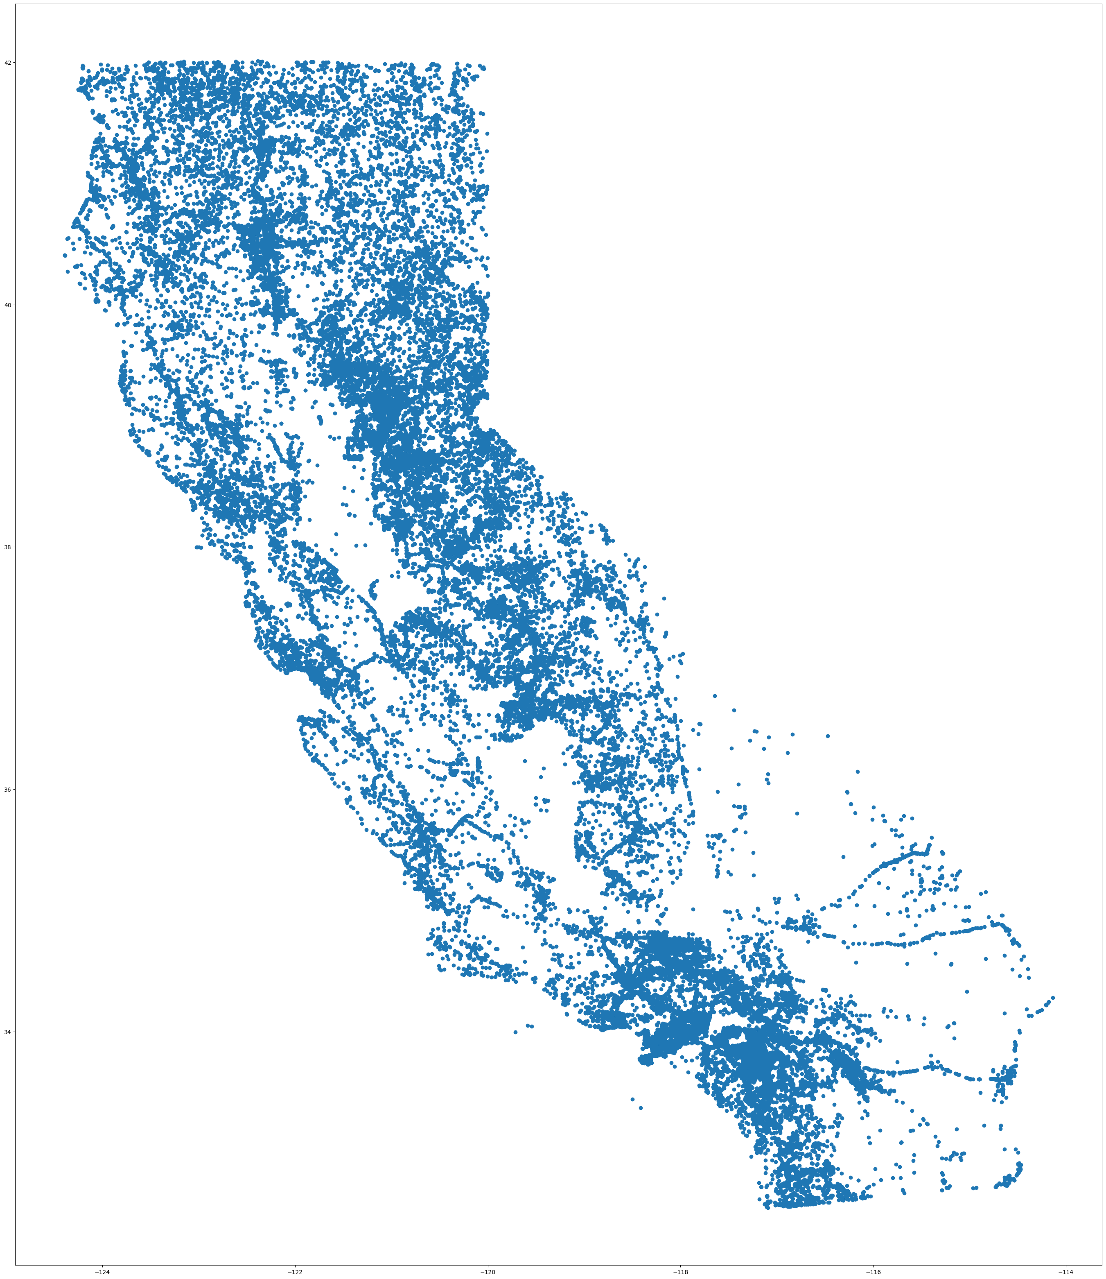
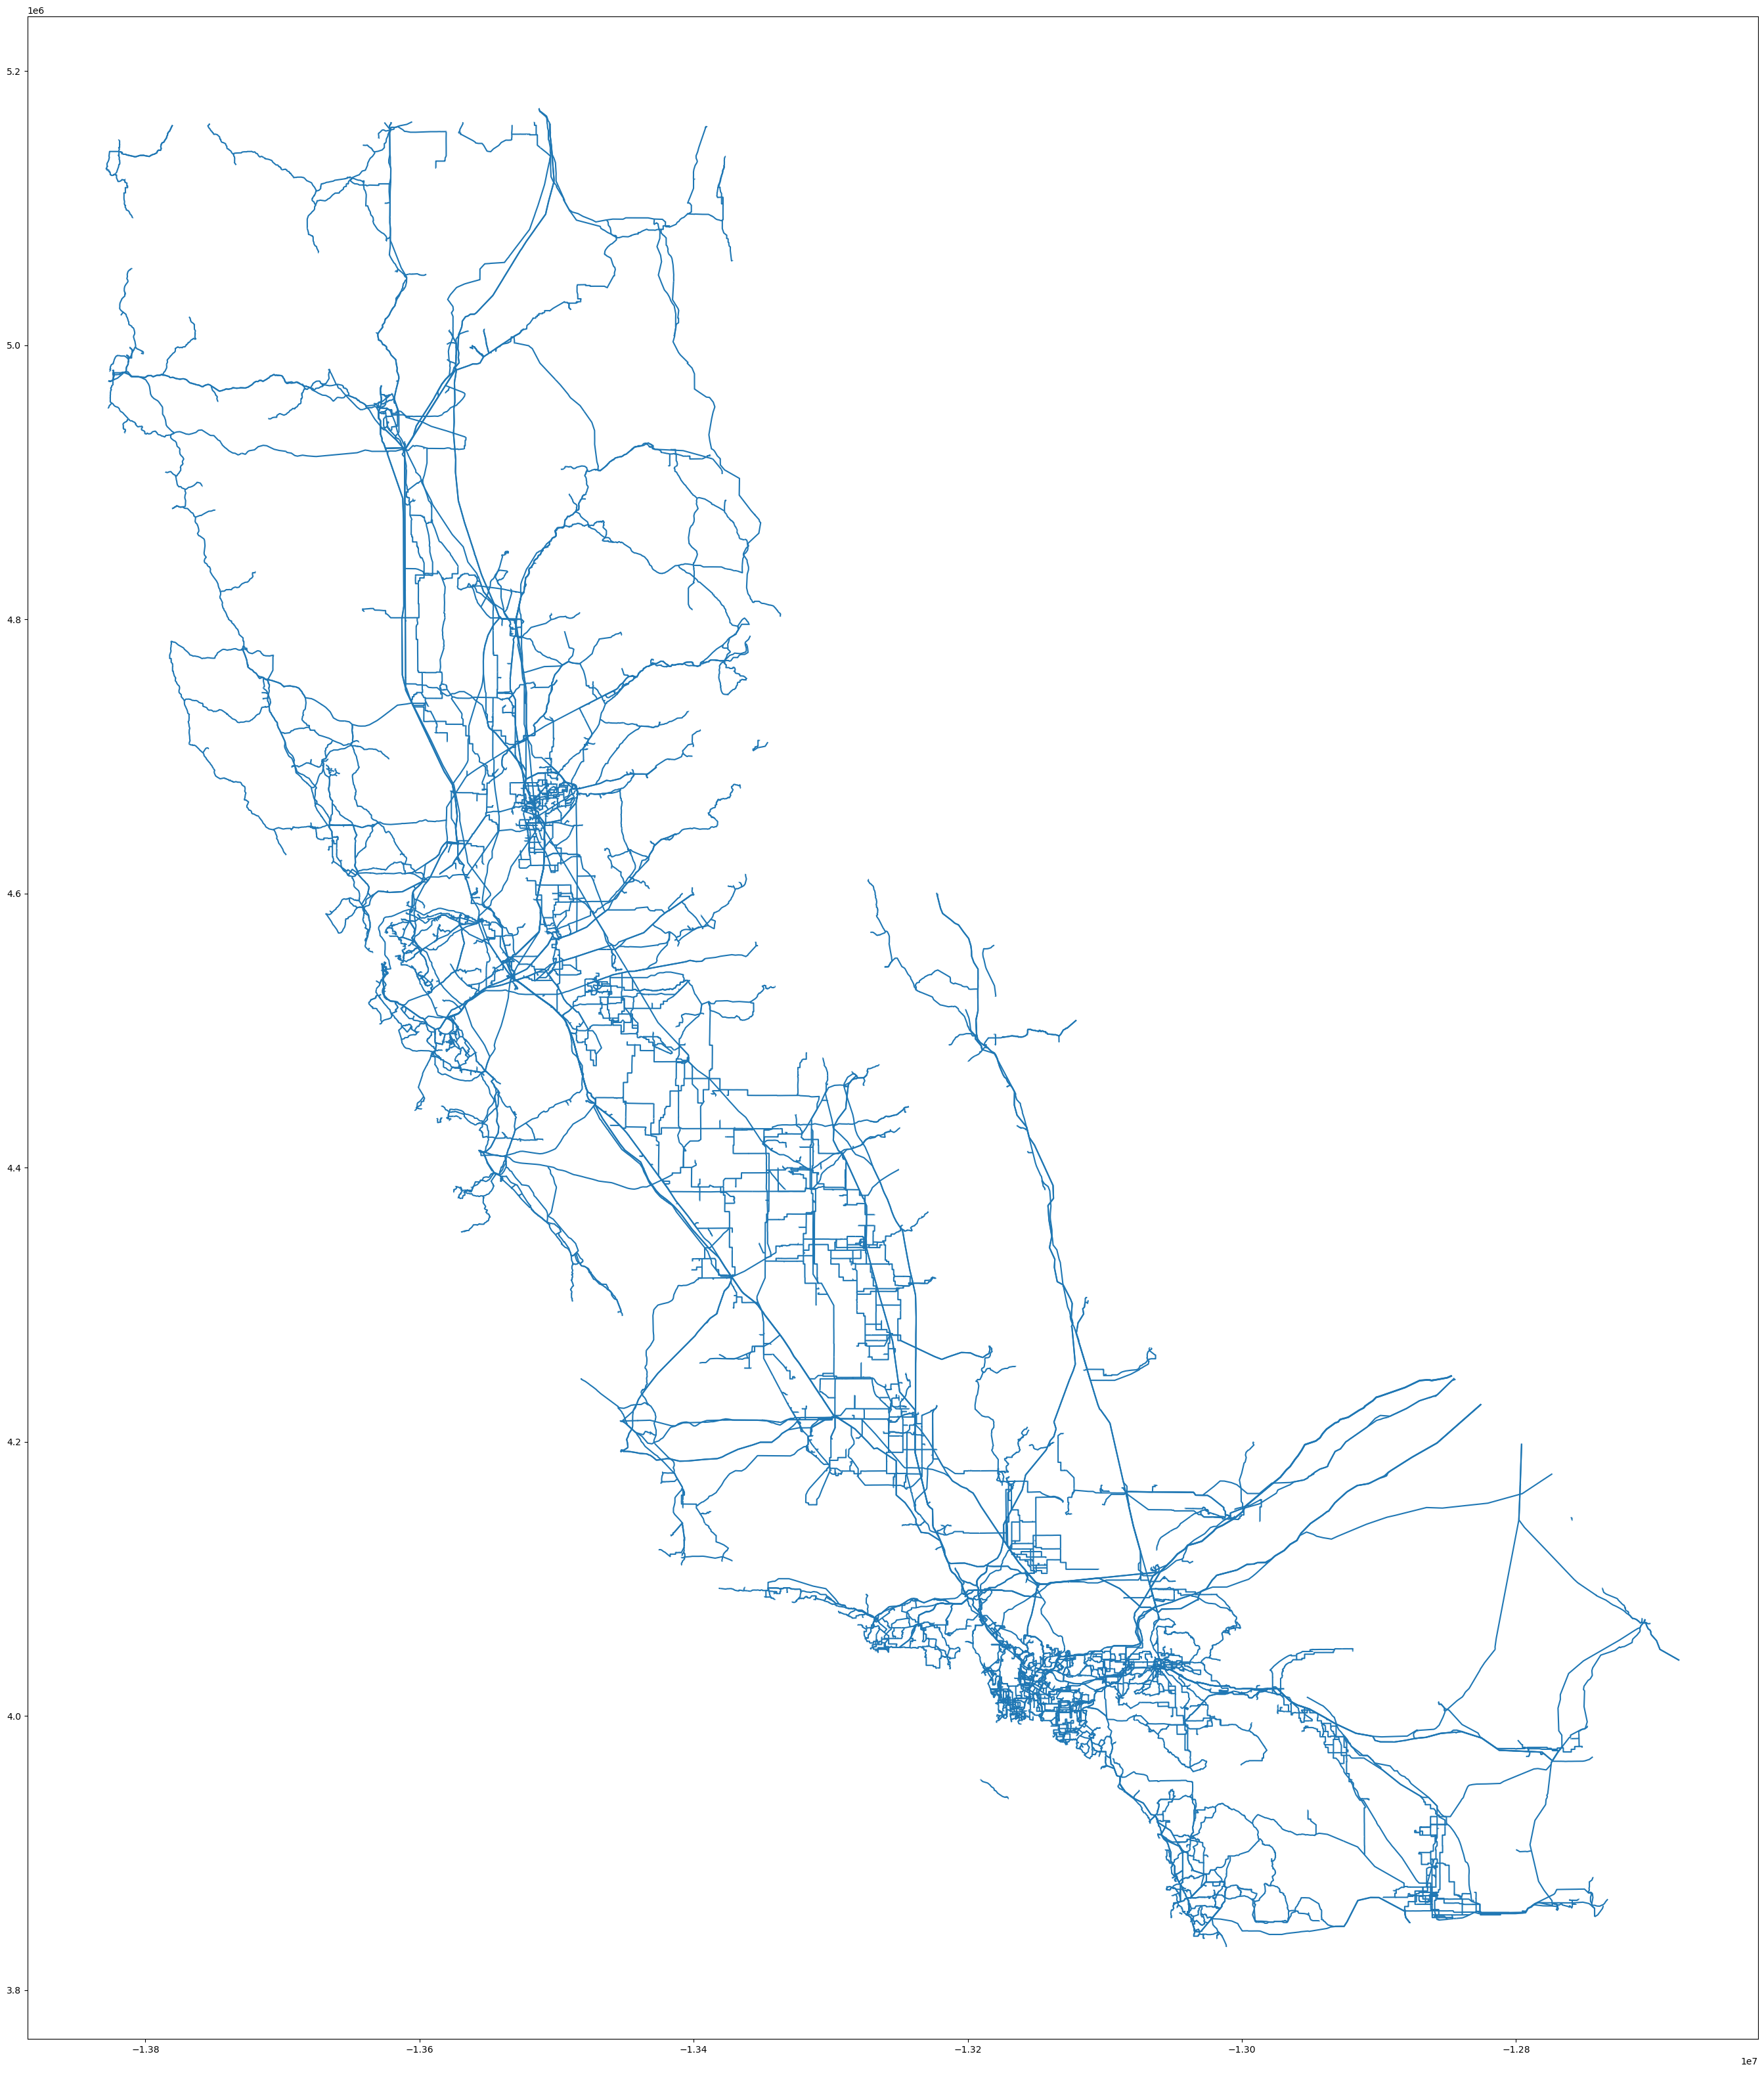
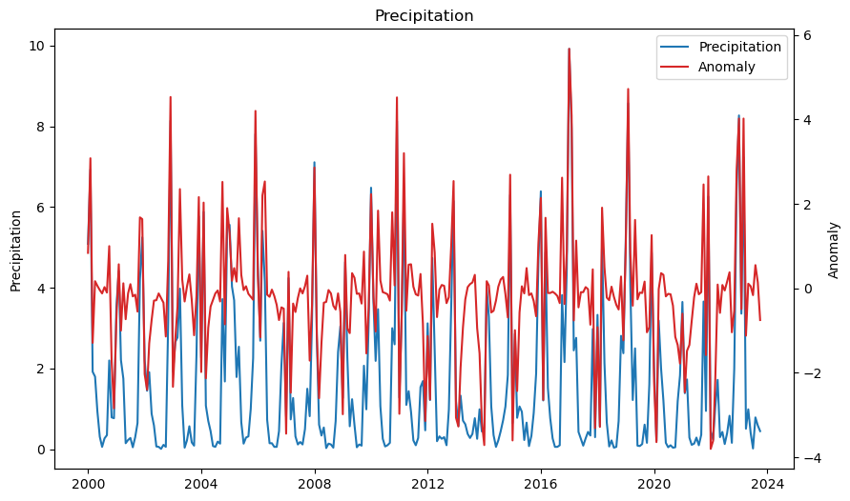
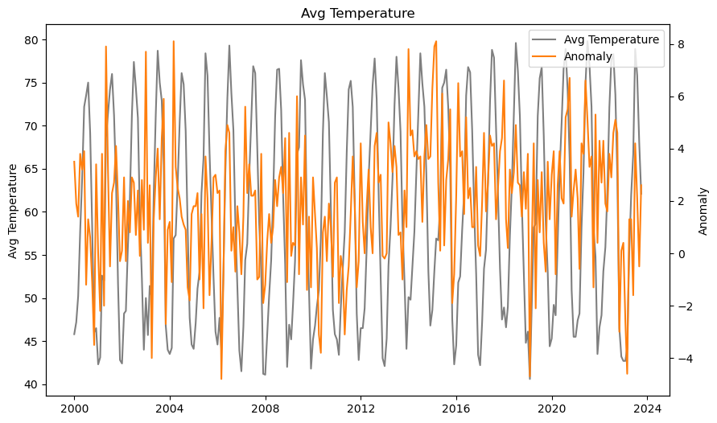
Visual representation of the data sets
Wildfire Data
Transmission Lines
Weather (Temperatures + Precipitation)
Geospatial dataset with a Point geography component
Geospatial dataset with a line geography component
Notes:
Spencer

Slide 8
Feature Engineering & Selection

Slide 9
Feature Selection
Bucket wildfires based on size
Rationale: This determines whether the wildfire incident was above or below the average size based on the acreage compared to the reported average acreage of wildfires in the United States from 2011 to 2019 (119 acres). This could be used to reflect the severity of a fire.
Calculation: Bucket the 'FinalAcres' column using bins of zero to 119 and 119 to the upper bound and label them "Below Average' or 'Above Average' accordingly
Close to Lines (Y / N)
Rationale: This could be used to determine if a transmission line caused the wildfire. It would be important to understand if a transmission line or tower had fallen near the time of the wildfire (outside of our scope for this project).
Calculation: A buffer of 200 meters is created around each transmission line. The buffered Transmission Line data was then spatially joined to the wildfire data, using the predicate 'within' so any wildfire within the 200 meter buffered would be included. If the wildfire incident is within the boundaries of a buffered transmission line, a value of ‘Y’ is assigned to the incident, otherwise a value of ‘N’ is assigned.
Notes:
If you worked on the feature, talk about it..

Slide 10
Feature Selection
Extreme Weather Index
Rationale: An index that accounts for both precipitation and temperature would be able to help account fo the combine effect of the two. Typically, it is thought that dry and hot conditions lead to wildfires, so this feature would help capture that
Calculation: The normalized temperature anomaly plus the negative normalized precipitation anomaly. The anomaly values were normalized to eliminate the variance in units between the precipitation and average temperature.
Relation between wildfires and precipitation
Rationale: See if trend between amount of precipitation and the number of wildfires
Calculation: Count of wildfires per month divided by the reported precipitation for that month
Relation between wildfires and average temperature
Rationale: See if trend between average temperature and the number of wildfires
Calculation: Count of wildfires divided by the reported average temperature for that month
Notes:
If you worked on the feature, talk about it..

Slide 11
Feature Selection
Extreme Weather and Fire was Close to Lines
Rationale: See if certain conditions cause there to be more fires started near transmission lines
Calculation: True if a fire was started in a month with and extreme weather index that is greater than zero and was started within 200 m of a transmission line, False otherwise
Extreme Weather and Fire was not Close to Lines
Rationale: Use to compare to previous feature to see if the rate of fires started near transmission lines is significantly different to the other wildfires started in extreme weather
Calculation: True if a fire was started in a month with and extreme weather index that is greater than zero and was not started within 200 m of a transmission line
Notes:
If you worked on the feature, talk about it..

Slide 12
Next Steps
Additional weather data
Data on the wind in California since wind can increase the spread of a wildfire
Data set with temperature and precipitation at a weather station level
Temperature and precipitation can widely vary across a state, so a reported weather condition at the statewide level does not mean that a fire in a particular location was started under those conditions
Vegetation map of California
Look into density of vegetation, see where there is high tree volume that intersects with transmission lines
See if wildfires are more likely to begin in particular areas, either due to density or the type of vegetation
Create visualizations
Would help convey information
Time-series graphs and animations would help show the trend of temperature, rain, and count of wildfires over time
Merge with transmission line data to see which areas may be high risk for future wildfires
Notes:
Abbie.... want to kind of wrap stuff up with a conclusion here too as per rubric
These features would create a good baseline for an investigation into wildfires in California, but there are a few more areas that we think would be beneficial to investigate if there were more time or further analysis done on this topic.
Source for info on wind: https://www.weather.gov/safety/wind-mountain-valley#:~:text=These%20strong%20winds%20can%20cause,a%20flame%20across%20the%20landscape.

Slide 13
Sources
https://www.weather.gov/safety/wind-mountain-valley#:~:text=These%20strong%20winds%20can%20cause,a%20flame%20across%20the%20landscape.
Datasets:
Wildfires
Dataset: https://data-nifc.opendata.arcgis.com/datasets/nifc::wildland-fire-incident-locations/explore?location=42.818955%2C-96.811606%2C4.90&showTable=true
Weather
Dataset: https://www.ncei.noaa.gov/access/monitoring/climate-at-a-glance/statewide/time-series/4/tavg/all/8/2000-2023?base_prd=true&begbaseyear=1901&endbaseyear=2000
Precipitation/Drought
Dataset: https://www.ncei.noaa.gov/access/monitoring/climate-at-a-glance/statewide/time-series/4/pcp/all/8/2000-2023?base_prd=true&begbaseyear=1901&endbaseyear=2000
Transmission lines
Dataset: https://gis.data.ca.gov/datasets/260b4513acdb4a3a8e4d64e69fc84fee/explore

Slide 14
Questions?

Slide 15
Appendix

Slide 16
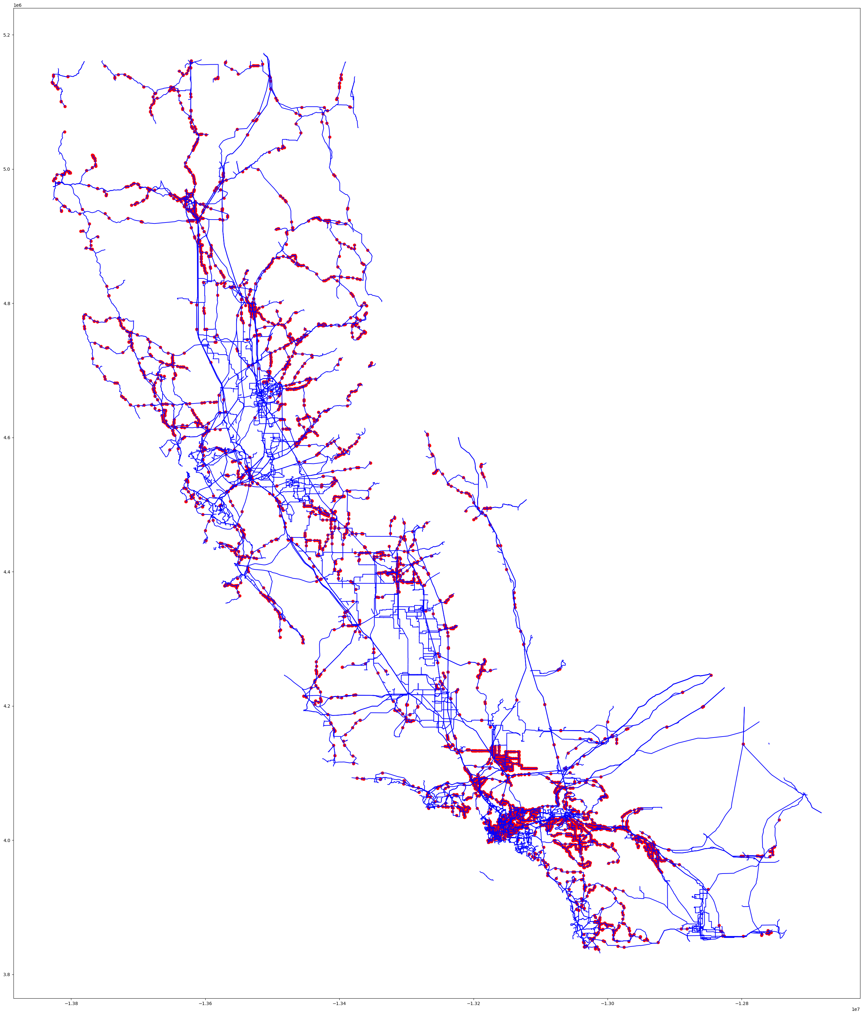
Wildfire Incidents
Spatial Join
Left join of Transmission Lines with fires using 'Within' predicate
Geospatial dataset with a Point geography component
Notes:
Sam

Slide 17
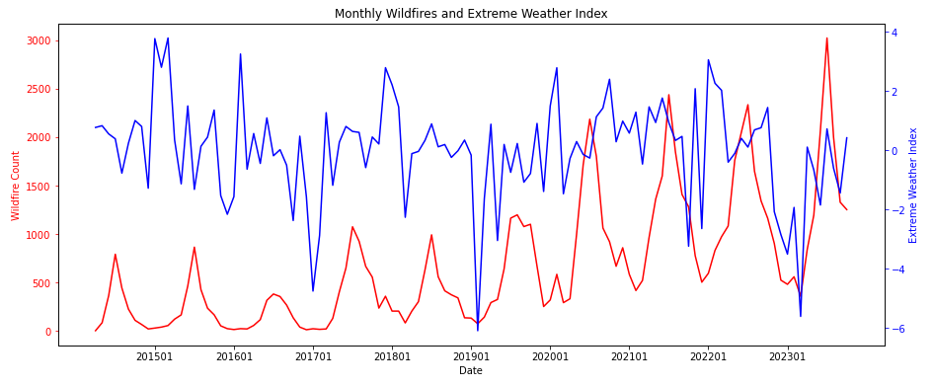
Extreme Weather Index feature vs # of Wildfires

Slide 18
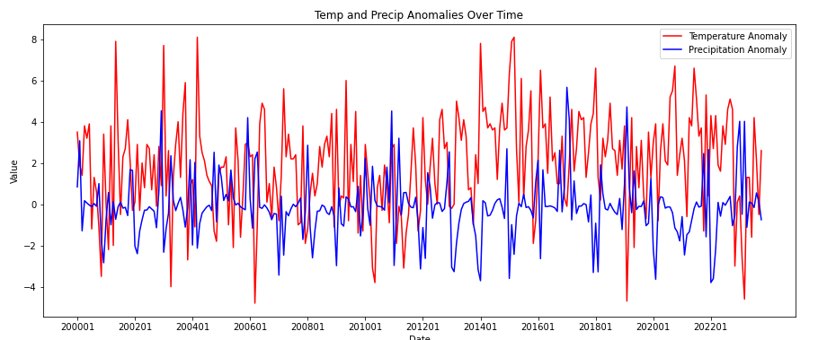
Average Temperature and Anomalies

Slide 19

Transmission Lines
200 Meter Buffer
Buffer created to identify where wildfires overlap with transmission lines (used later in features)
Geospatial dataset with a line geography component

